Slide 1
Brain MRI Segmentation: Harnessing U-Net for Automated Tumor Detection
Automated and Efficient Segmentation of Brain Tumors Using U-Net

Slide 2
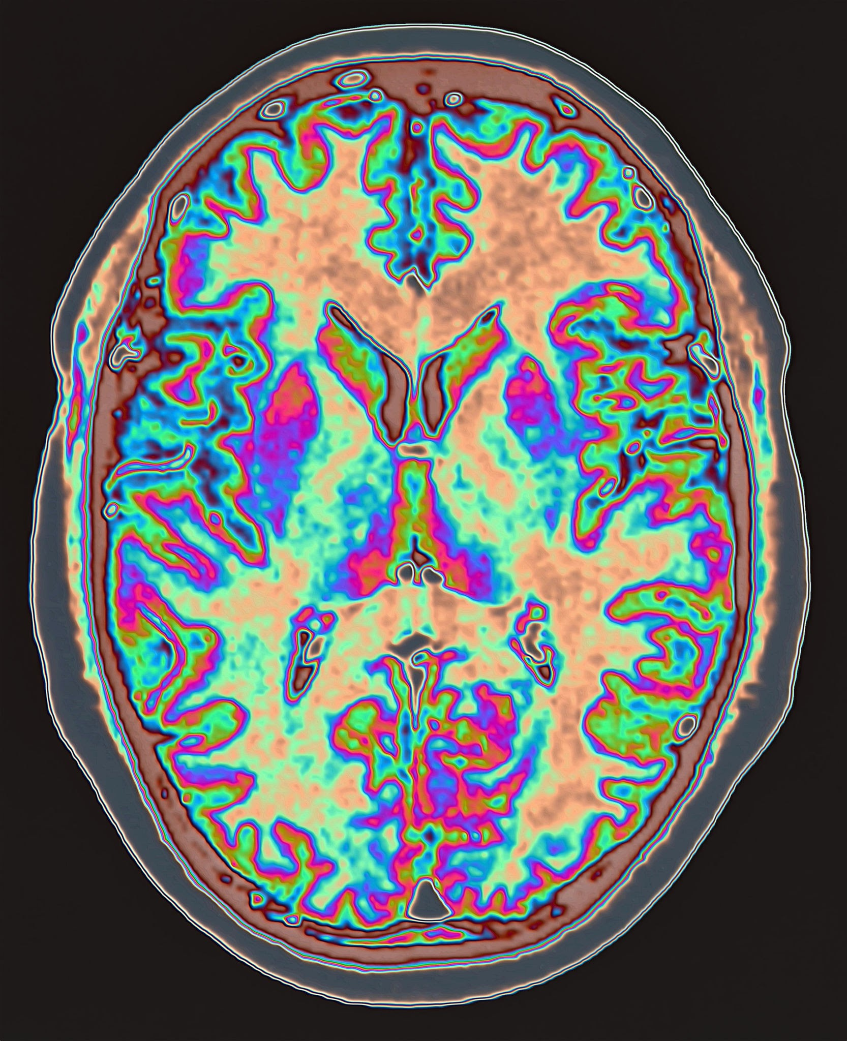
Introduction
Brain tumors are life-threatening and require accurate diagnosis.
Manual segmentation is time-consuming and error-prone.
Our goal: Automate brain tumor segmentation from MRI using U-Net.
Dataset used: TCGA-LGG (Low Grade Glioma)
Photo by Pixels

Slide 3
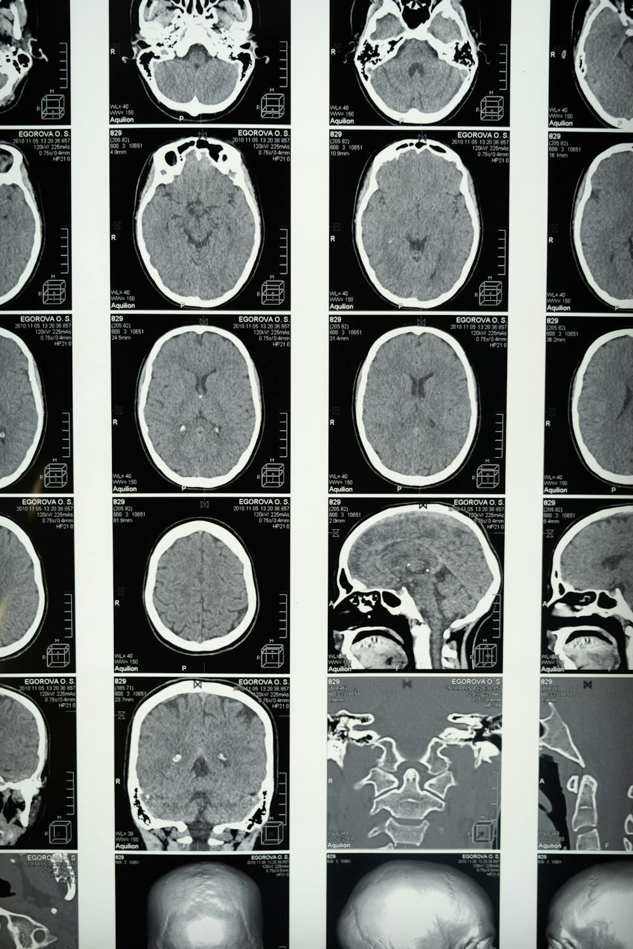
Motivation
Gliomas can progress and become dangerous if untreated.
Early detection improves outcomes.
Deep learning ensures speed, consistency, and accuracy.
Photo by Pixels

Slide 4
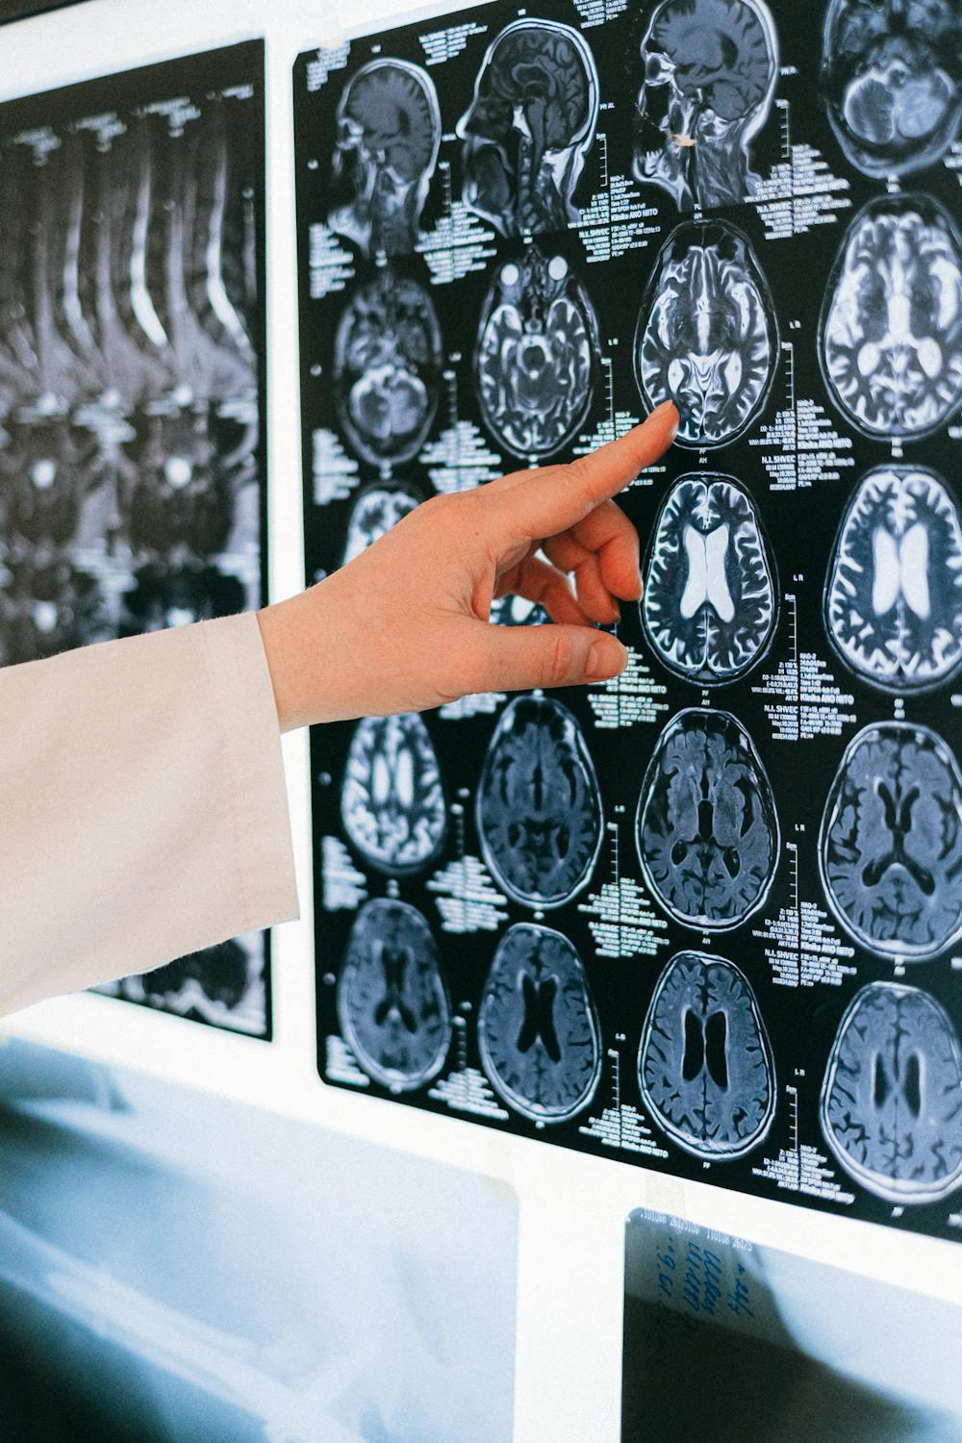
Dataset Overview
Source: The Cancer Imaging Archive (TCIA)
MRI modality: FLAIR
Total image–mask pairs: 3,929
Image size: Resized to 256x256 pixels
Mask type: Binary masks
Photo by Pixels

Slide 5
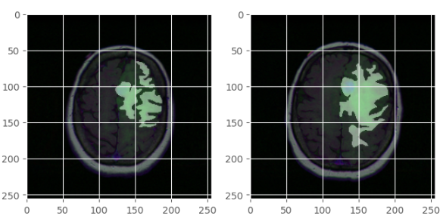
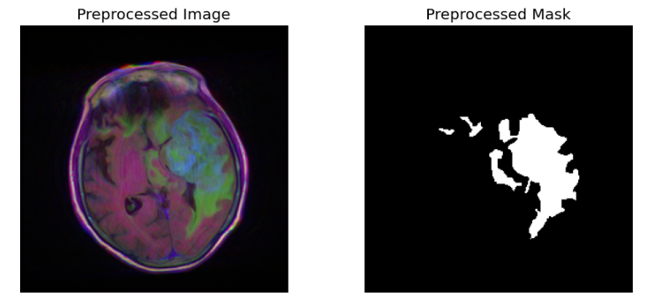
Preprocessing Steps
Paired MRI and mask files
Normalized pixel values to [0, 1]
Resize all images
Converted grayscale masks to binary using threshold 0.5
Photo by Pixels

Slide 6
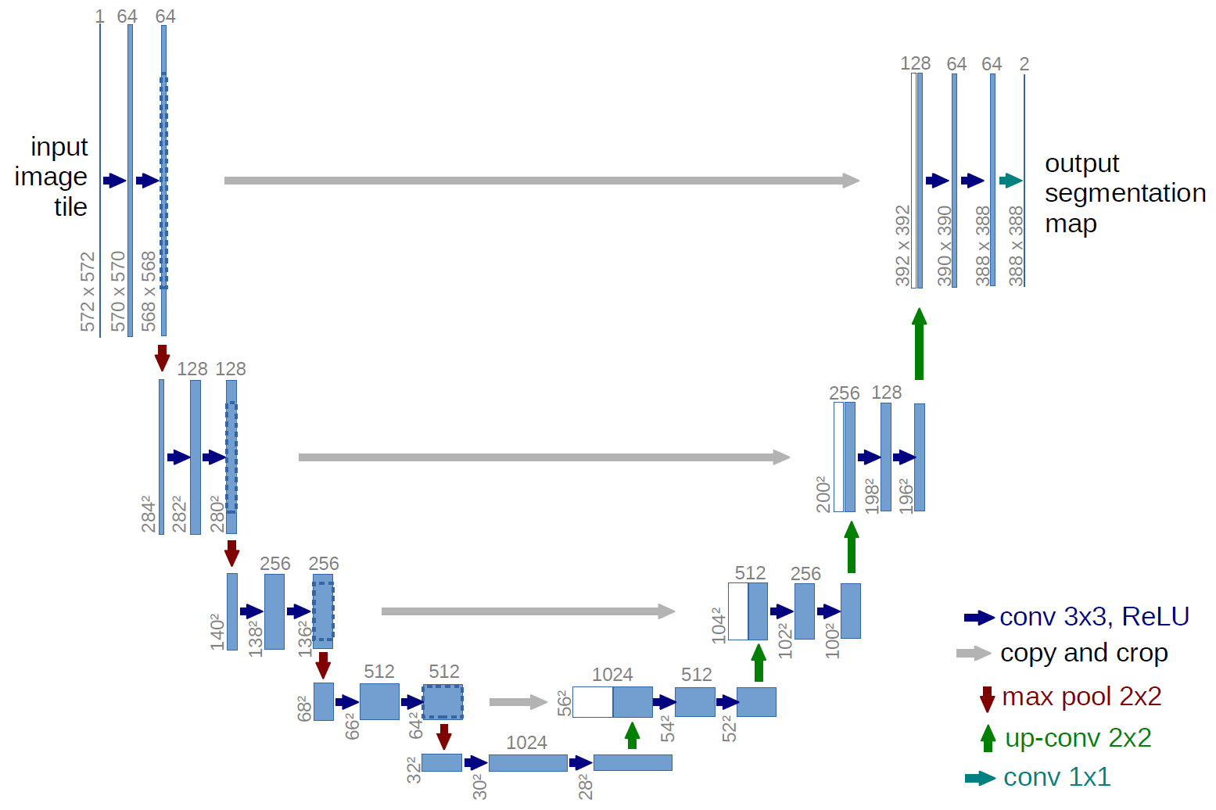
U-Net Architecture
Encoder-decoder structure
Skip connections for feature reuse
Encoder: Convolution + Max Pooling (64 to 1024 filters)
Decoder: Transposed Conv + Concatenation (1024 to 64 filters)
Final layer: 1x1 conv + Sigmoid for binary segmentation
Photo by Pixels

Slide 7
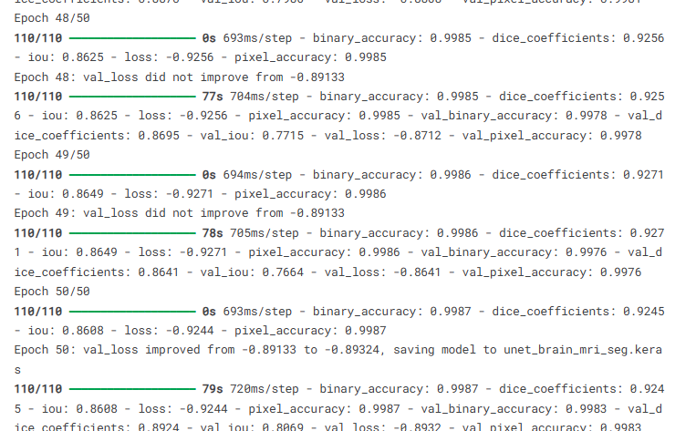
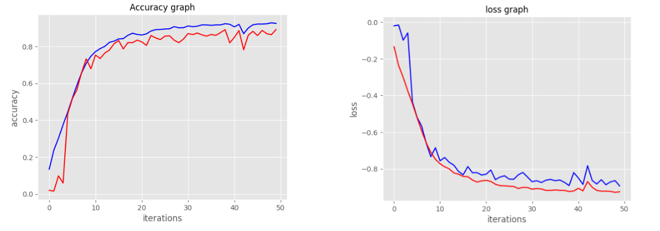
Model Training
Optimizer: Adam (lr = 1e-4)
Loss function: Dice Loss
Epochs: 80
Batch size: 32
Callbacks: Early Stopping and Model Checkpoint
Photo by Pixels

Slide 8
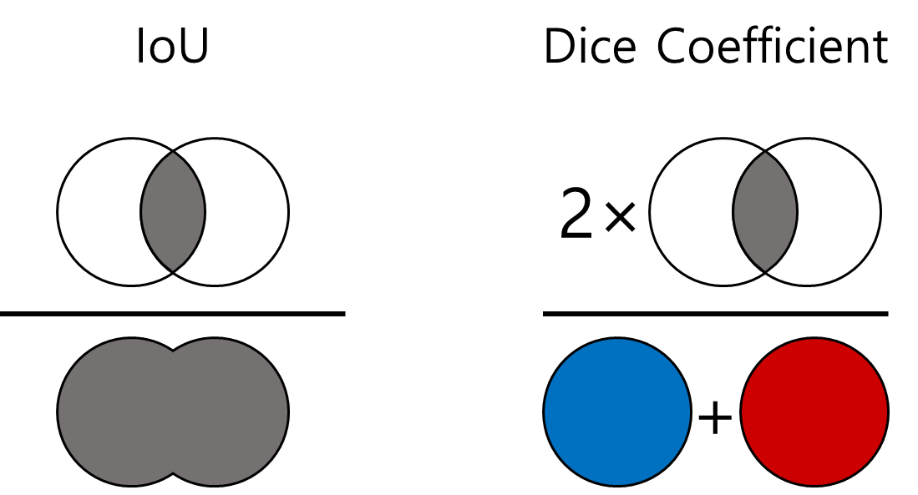
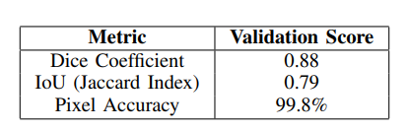
Evaluation Matrices
Dice Coefficient – measures overlap accuracy
IoU (Jaccard Index) – stricter overlap metric
Pixel Accuracy – overall correct pixel classification
Photo by Pixels

Slide 9
Results
Dice Score: 0.88
IoU: 0.79
Pixel Accuracy: 99.8%
Performance improved steadily after epoch 30
Photo by Pixels

Slide 10
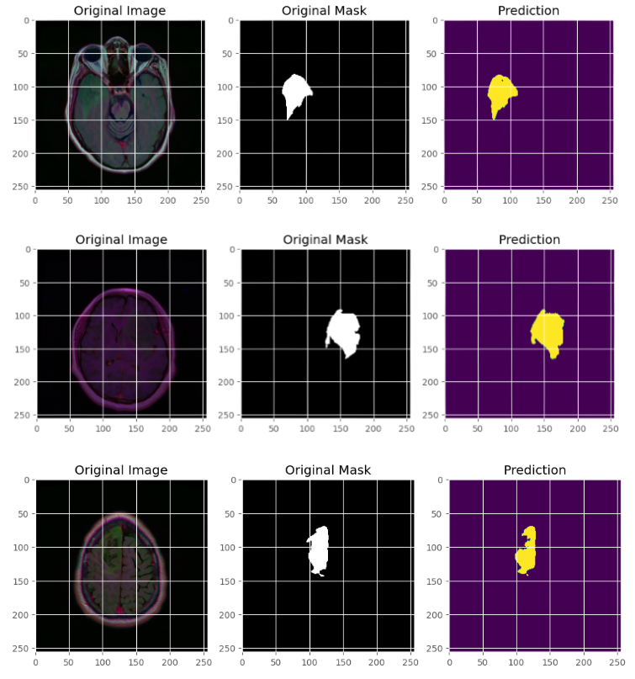
Visual Results
Example images with:
  Original MRI
  Ground truth mask
  Predicted mask by U-Net
Strong visual similarity between prediction and ground truth
Photo by Pixels

Slide 11
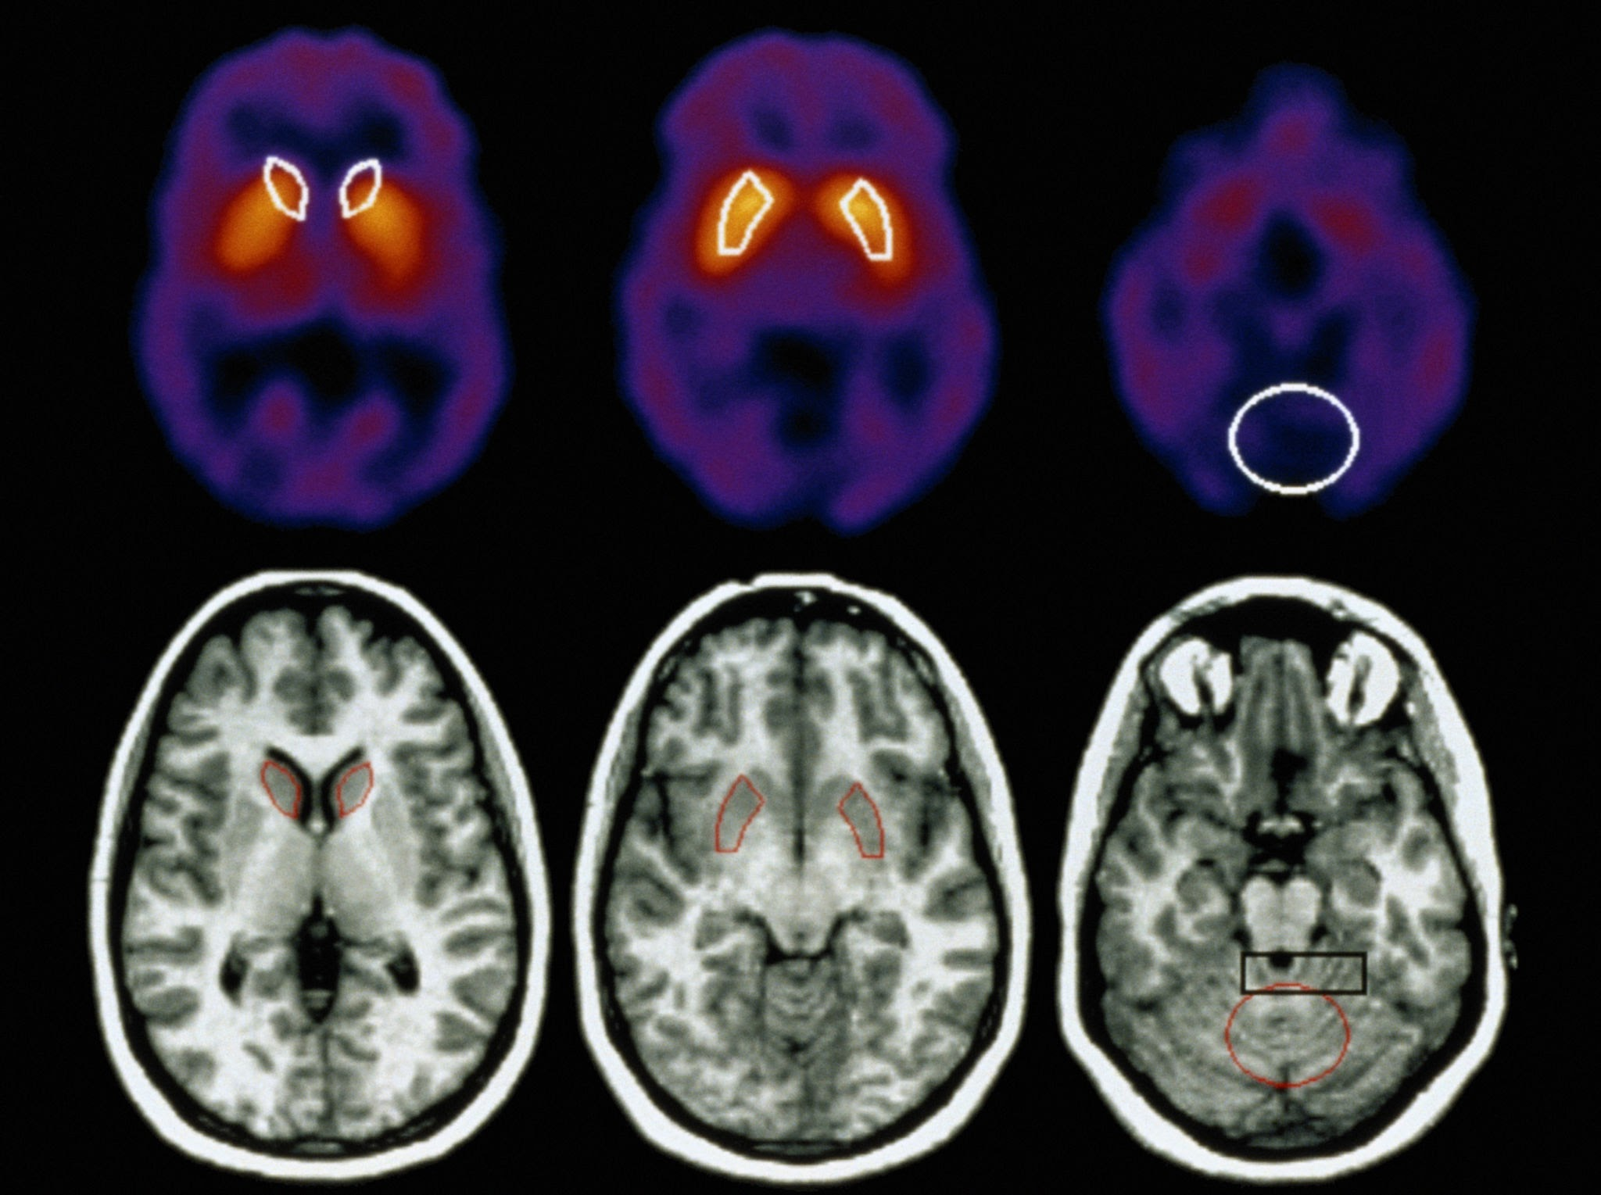
Challenges Faced
Detecting small tumor regions
Model worked only on 2D slices
Used only one modality (FLAIR)
Photo by Pixels

Slide 12
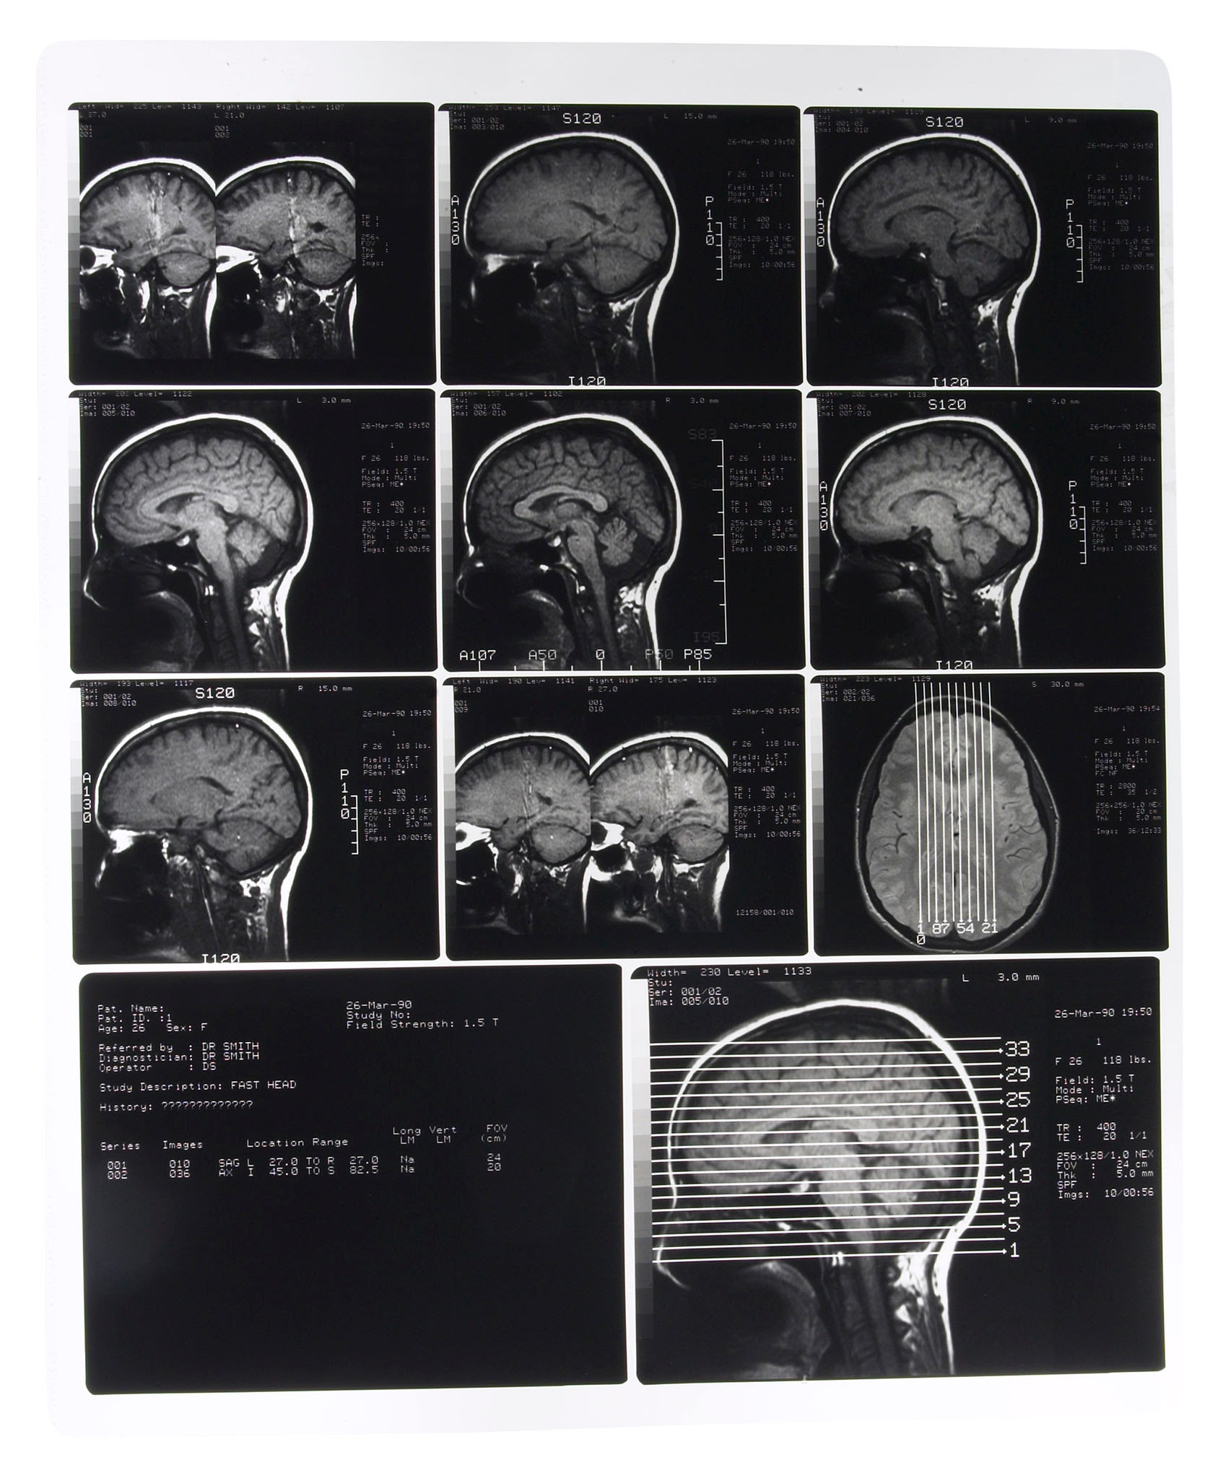
Conclusion & Future Works
Automated U-Net model performed effectively.
Reduced burden on radiologists.
Future improvements:
  Multi-modal input (T1, T2, FLAIR)
  3D U-Net for volumetric data
  Post-processing (CRF, morphology)
Photo by Pixels

Slide 13
THANK YOU!

